Slide 1
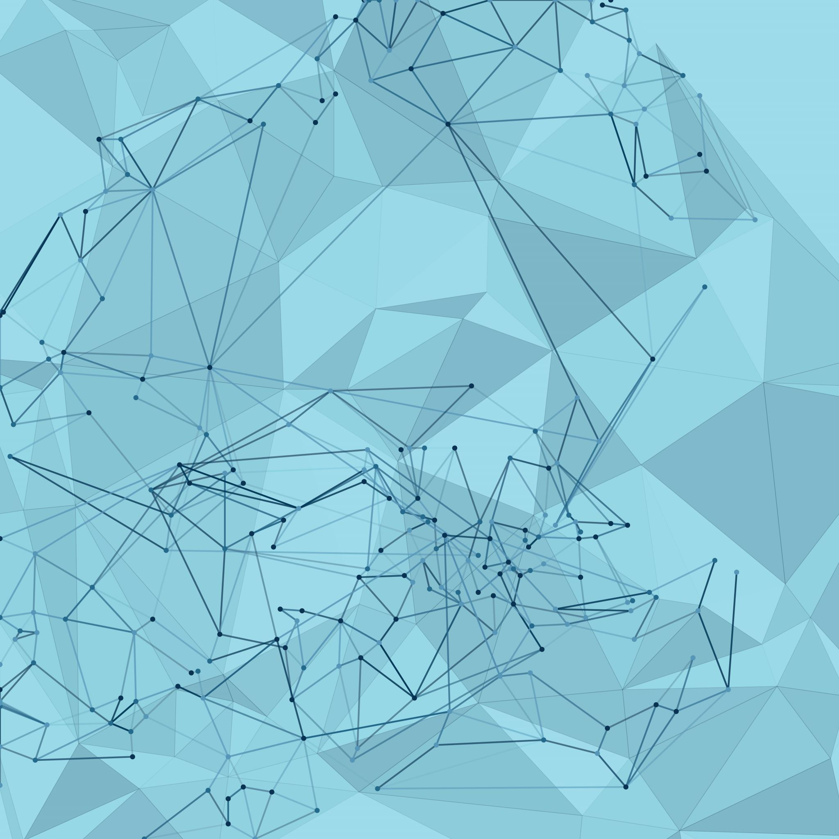
Product Design
Mahesh Natarajan

Slide 2
Get to know…
Go to www.menti.com and use the code 4307 0457

Slide 3
Adapted/ Reference from
Sawtooth Software, Inc. materials
Gartner Research
HBR
Reference mtl & Web
GenAI

Slide 4
Books & App of interest
Business Model Generation and Value Proposition Design: by Alexander Osterwalder
The Lean Startup: by Eric Ries
The Hard Thing About Hard Things by Ben Horowitz
the other side of innovation – Vijay Govindarajan & Chris Trimble
The Four Steps to the Epiphany:
The Innovator’s Dilemma & The Innovator’s Solution by Clayton M. Christensen
Crossing the Chasm: Marketing and Selling High-Tech Products to Mainstream Customers
The Tipping Point: How Little Things Can Make a Big Difference by Malcolm Gladwell
Blue Ocean Strategy: How to Create Uncontested Market Space and Make Competition Irrelevant by R. Mauborgne and W. C. Kim
Competitive Strategy, Competitive Advantage by Michael Porter
Innovators Dilemma & Innovator Solution, Clayton Christensen
Breakthrough Products with Lead User Research by Eric Von Hippel and Mary Sonnack
The Ambidextrous Organization, Charles O’Reilly/Michael Tushman: April 2004
The Goal by Eliyahu Goldratt
Good To Great and Built to Last by James C. Collins, Jerry I. Porras
https://www.digitalnatives.hu/blog/minimum-viable-product/
https://www.strategyzer.com/app

Slide 5
What you will learn in this session
Key aspects of Product Design
Product LifeCycle Management & Product Engineering
Career Choice
Developing complex solutions for addressing market needs
DFX

Slide 6


Mahesh Natarajan Senior Director- R&D ThermoFisher Scientific
Professional Background
Responsible for Innovation, New Product Development, sustenance Engineering
Engineering with System Controls, Reliability Practioner, BB Six Sigma ; Ex. MBA
Worked in US, Mexico, Europe, India
Worked in Life Science, consumer product, Industrial supplies, semiconductor industry
7 granted patents in USPTO
Alternative Career or Hobby
Like Biking, slow run/jog long distance ; foodie ☺
Recent interest: culture & nature immersion
Guide Students, work w NGO ; Teach at IIMu & IIIT

Slide 7
Key concepts
Product Lifecycle Management
Innovation
Customer Insights
Design & Development
Market Timing
Design Thinking/doing
Measurement & Optimisation
Product Management

Slide 8
Getting Started Go to www.menti.com and use the code 1302 3883

Slide 9
Product is anything that a business sells to address a customer's need or want. Products can be physical, virtual, or services.
Physical
Virtual
Services:
Combination
Durable goods like cars, furniture, and computers, or nondurable goods like food and beverages
Music streaming services or video game software
Mortgages, loans, food delivery services, or home security packages
Products can also be a combination of physical and virtual elements, like a smartwatch that monitors health stats and provides a service plan.

Slide 10
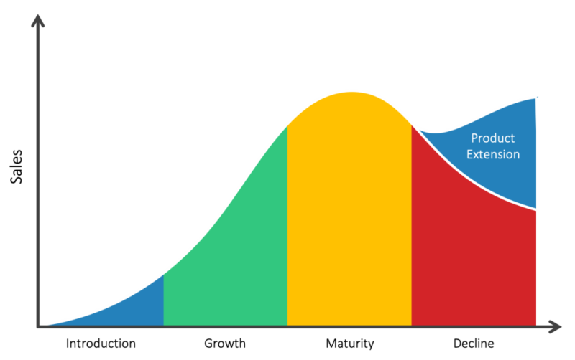
Product LifeCycle Management
Ideation
Product Design
Development & Eng.
Validation & Verification
Deployment & Launch
Optimization
EOL Management
Idea Generation
Concept Validation
Prototyping
Business case
Functional Design
Project Planning
Risk Assessment
Functional Engineering
Testing
Compliance & Regulatory
UAT
Performance Testing
Compliance Testing
Security Testing
Launch Support
Documentation
SW Installation & Configuration
Value Engineering
Tech Refresh
Scalability, Localization
Obs. Management
Sustenance Management
Re-engineering
Legacy Support

Slide 11
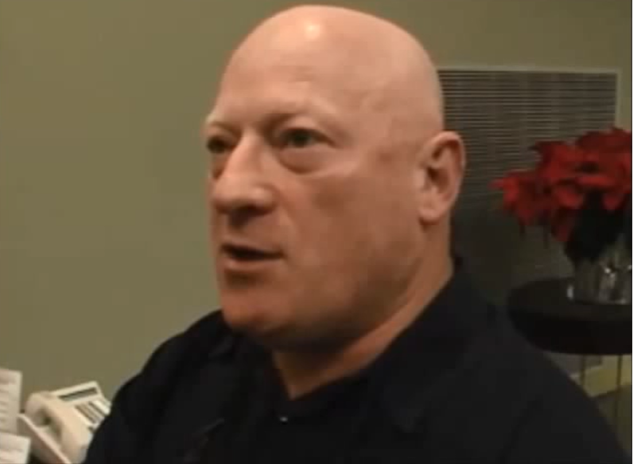
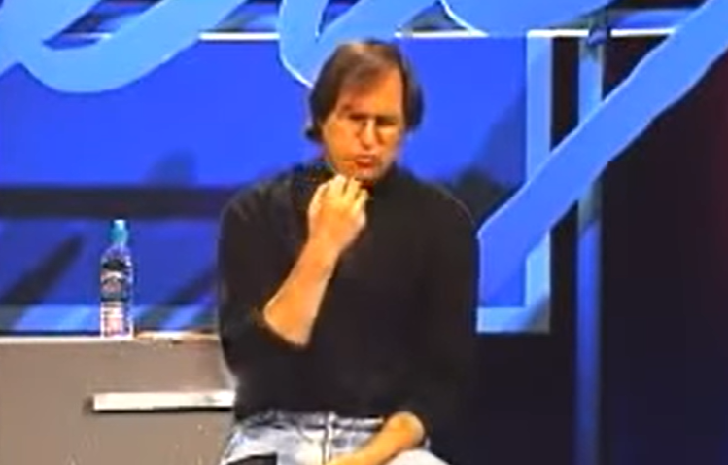
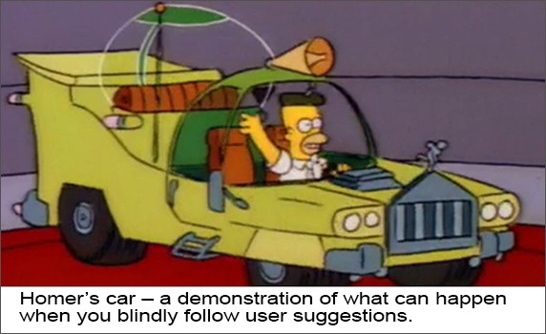
What's a good place to start your product design …
https://youtu.be/B-IM6r-T6q0
https://youtu.be/48j493tfO-o?t=105

Slide 12

Introduction to Product / tech -Driven Product Development
Find customers who need the features
Tech
Cool Features
Product / Tech Driven Product Development focuses on Market Push
High risk of failure
Typically slower speed to market
Approach typically taken for Break-Through Projects
Market Risk & Development Time
⇩

Slide 13
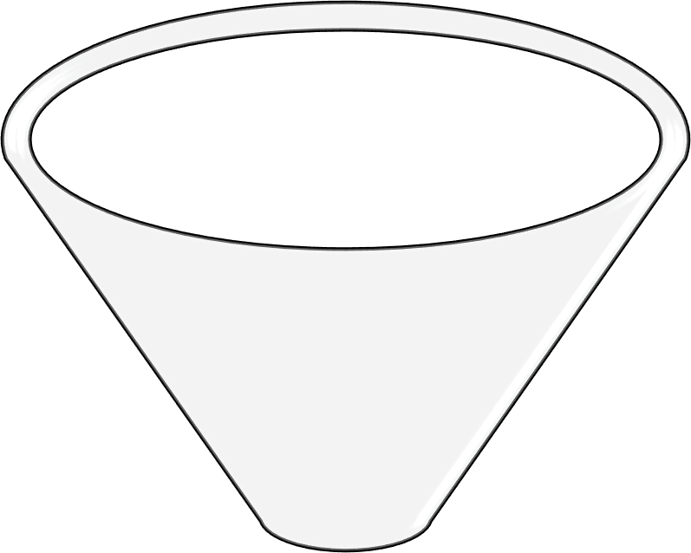
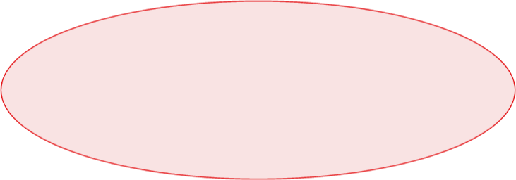
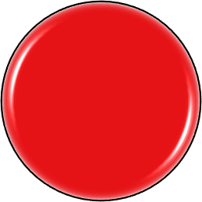
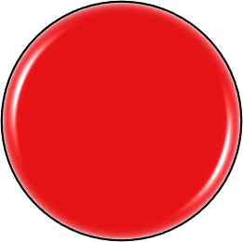
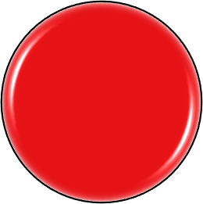
Introduction to Customer Centric Product Development
Customer Centric Product Development
Customer Centric Product Development focuses on Market Pull
Lower risk of failure
Good definition of customer requirements early drives speed to market
Approach typically taken for products in the market
Important to balance risk in portfolio
Customer Wants for Markets Identified
Value Proposition
Minimal Features for Customer Adoption Identified
Market Risk & Development Time
⇧

Slide 14
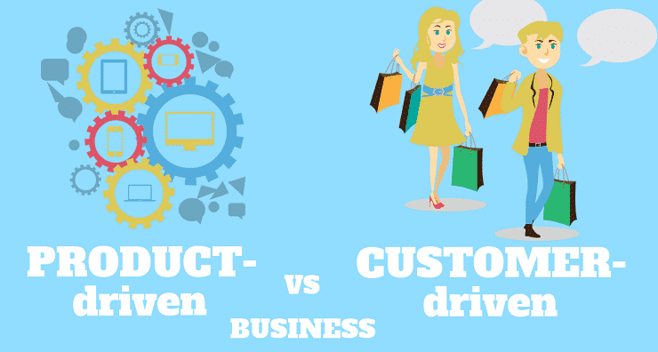
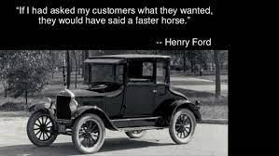
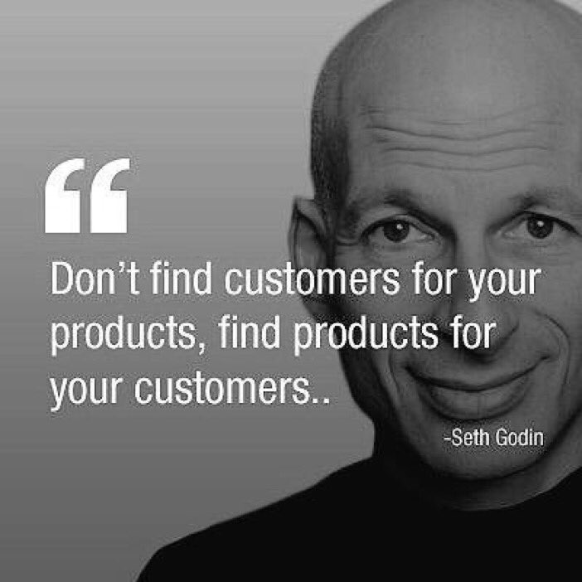
- When to use Product/tech Driven Vs Customer Driven
- What are the considerations to increase your odds of success in either approach

Slide 15

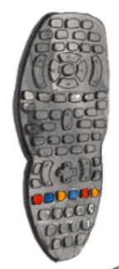
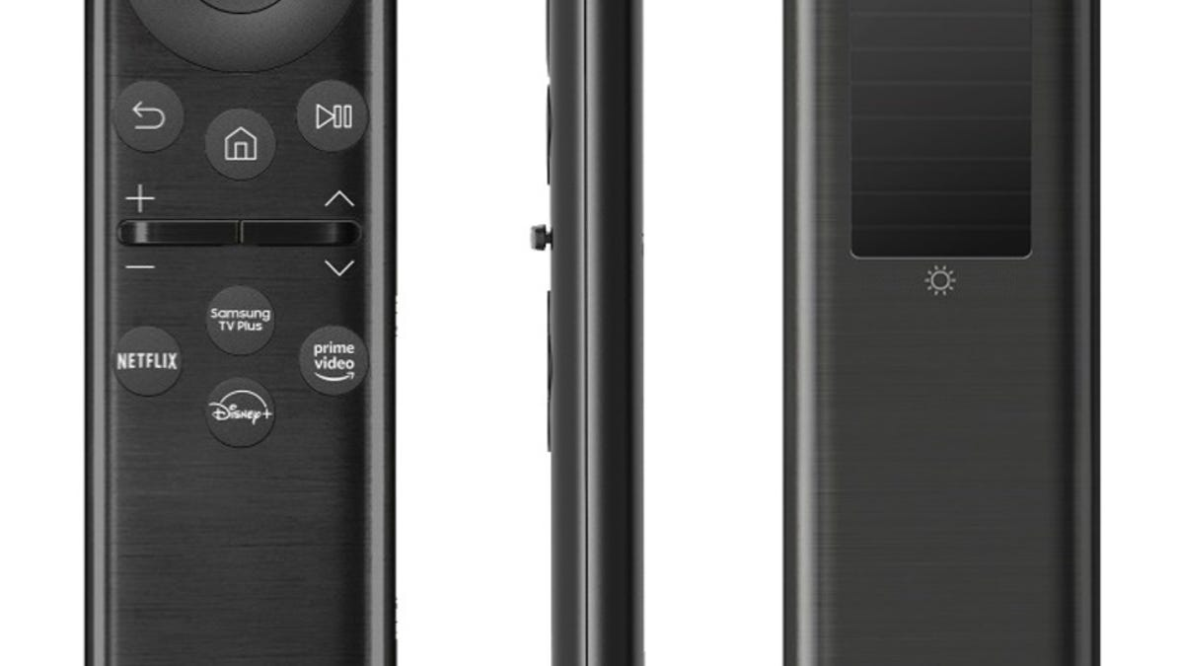
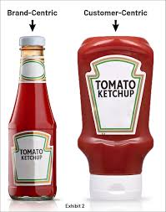
Shift from product centric to customercentric…
https://www.cnet.com/tech/home-entertainment/samsungs-new-eco-remotes-draw-power-from-radio-waves/

Slide 16
Go to www.menti.com and use the code 32872610

Slide 17
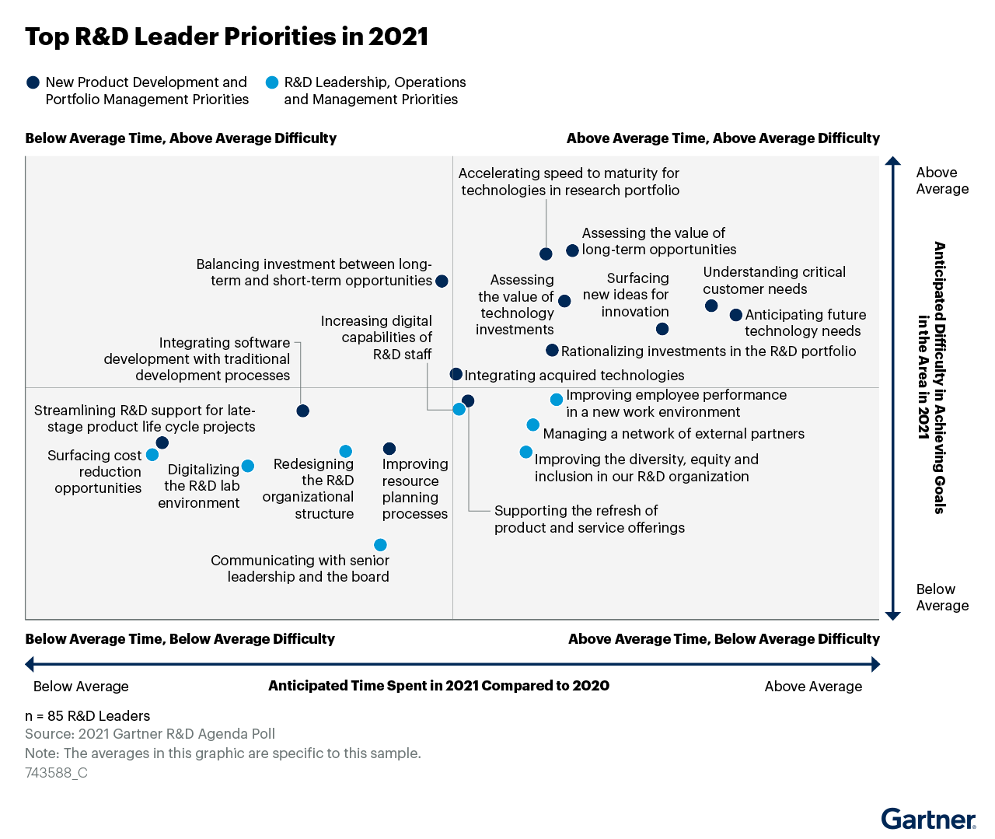
Why Customer understanding
Drives eventual success
Right the first time

Slide 18

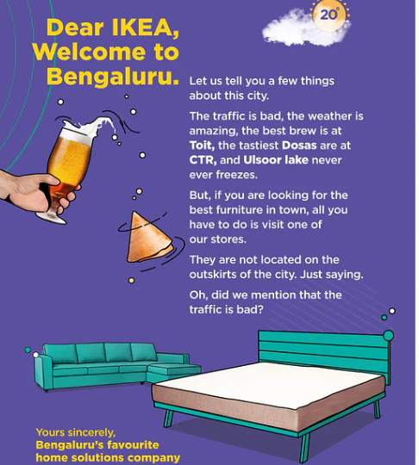
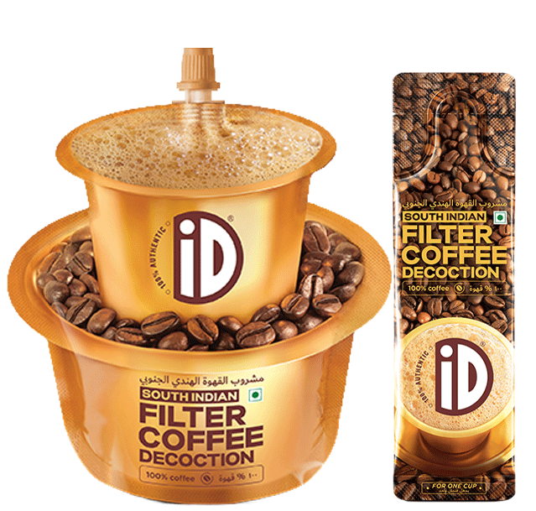


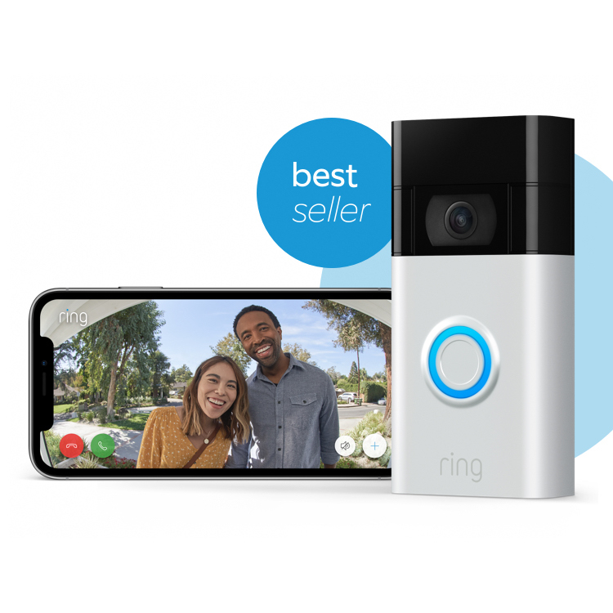
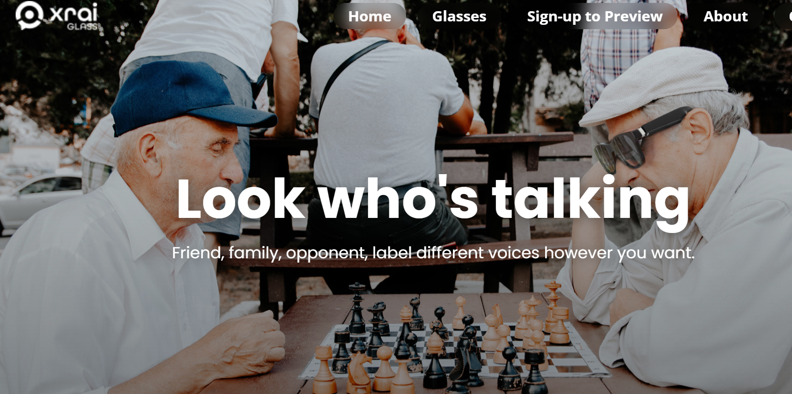
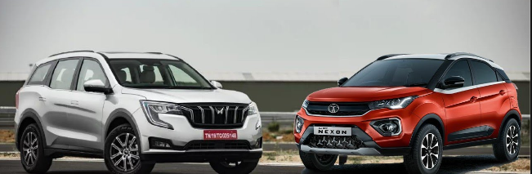
Power of customer centric design, executed well

Slide 19
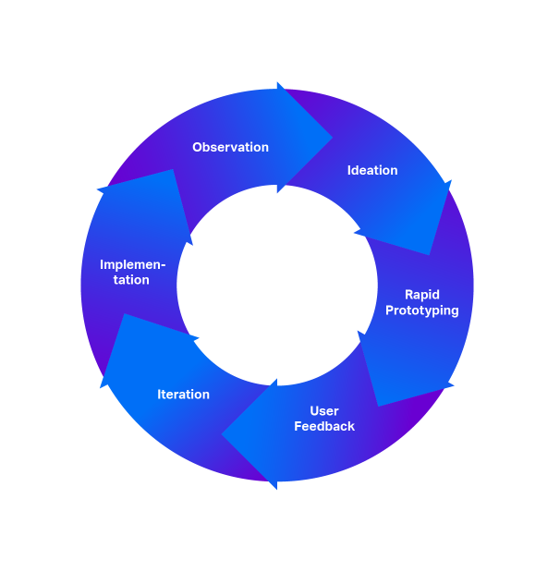
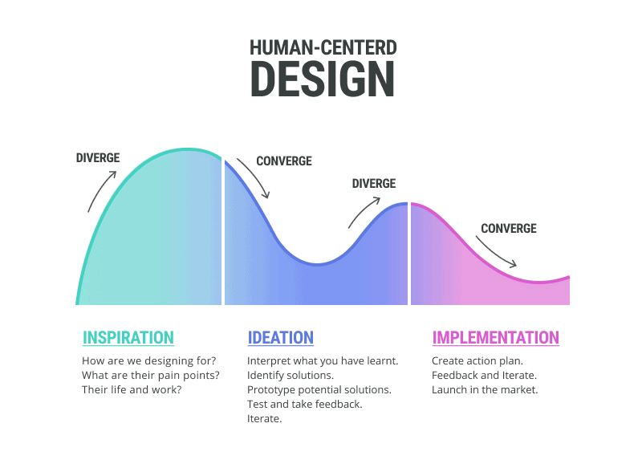
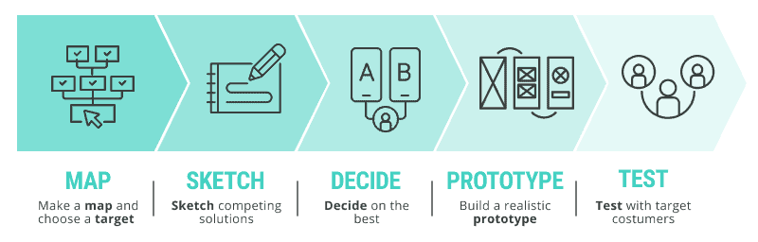
Evolution of customer-Centric design approaches…

Slide 20
Key Takeaways on why CCPD
Makes the organization Sustainable
Build Trust & Loyalty
focusing on customers gives you the advantage over your competition
Integration of Customer insight, Design Thinking, Validating customer needs(Lean, Agile)
Reduces Development Cost
Increases odds of Success / Reduces Risk

Slide 21
How to do Customer Centric Product Design (Optional)
Intro
Understanding Customer Needs & Wants
Gathering & Managing Customer Reqmts
Market Research
Quantitative & Qualitative analysis
Product Requirement Document
Customer Study
Feature Study
Product Roadmaps of Competition
UX
Requirement Analysis / Review
Post Sale customer study
Product Feedback Gathering & study
User journey analysis
Conjoint Analysis
VOC Methods
(Interviewing techniques)
Customer value mapping
QFD

Slide 22
Product Management Business Process of Planning, Developing, Launching and Managing a Product or Service *
Define Strategy: Develop and communicate the product vision and roadmap based on market needs and business goals.
Collaborate Across Teams: Work with engineering, design, marketing, and sales to guide product development and ensure alignment.
Gather and Prioritize Requirements: Translate customer needs and business objectives into actionable product features and priorities.
Oversee Development and Launch: Manage the product lifecycle from development to market launch, ensuring timely and successful delivery.
Monitor Performance and Iterate: Track product performance, gather user feedback, and make data-driven improvements to enhance the product.

Slide 23
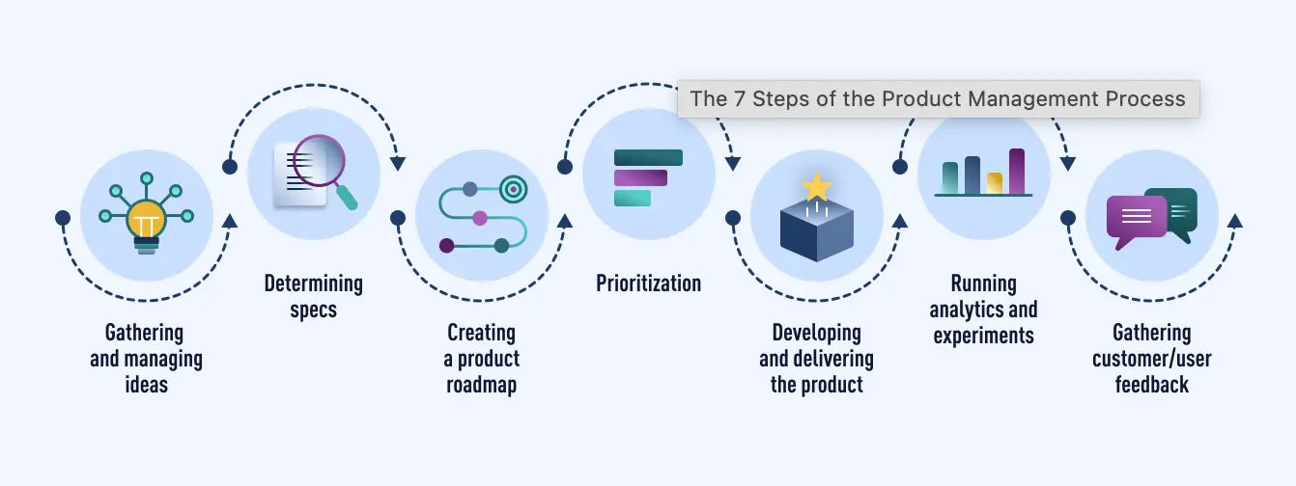
ProductManagement Process

Slide 24
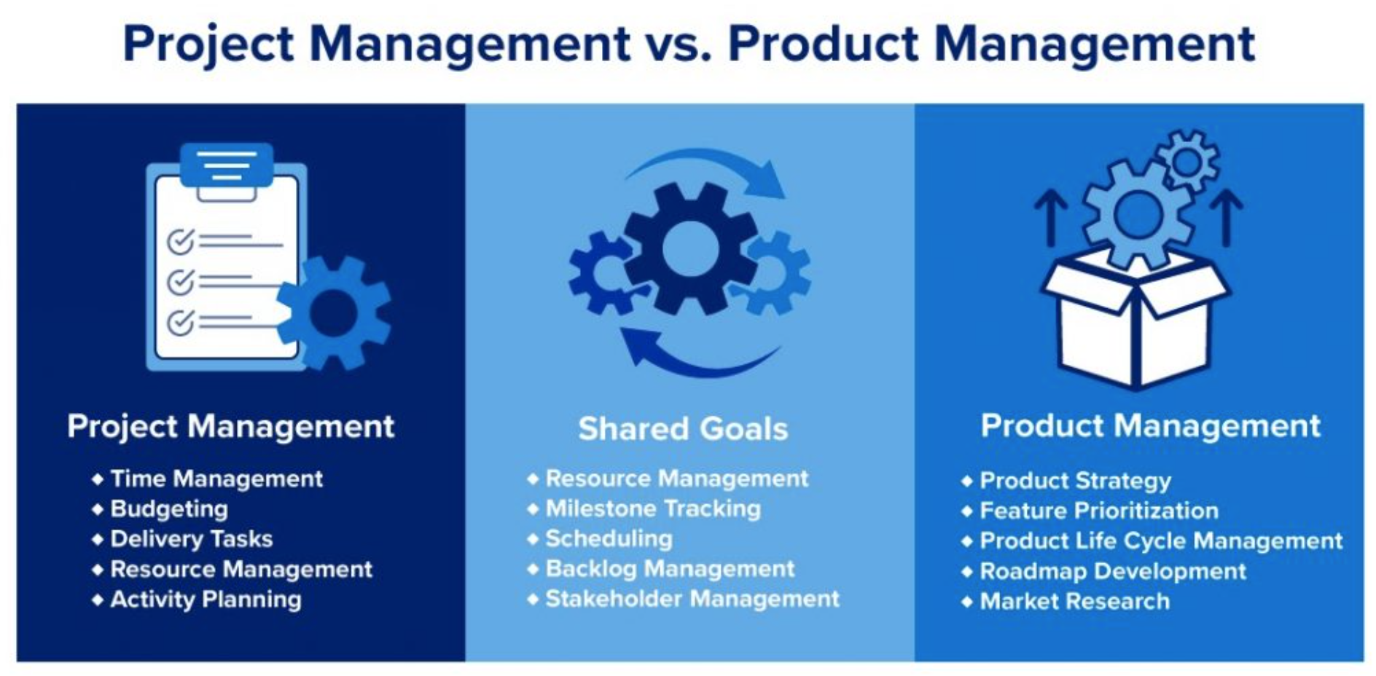
Project Management Vs Product Management

Slide 25
AI in Product Management(Optional)
Intro
Why you should adapt AI
Gathering & Managing Customer Reqmts
Market Research
How to make the most of this Module
Execution
Product Requirement Document
Sustenance & Mkt Growth
SEO Analysis with AI
Customer Study
Feature Study
Product Roadmaps of Competition
Data + Writing SQL Queries
User stories & Bugs
Python Scripts Data Analysis
User touch points review & Product improvements
Super customised emails for customers
UX
Requirement Analysis / Review
Post Sale customer study
Product Feedback Gathering & study
User journey analysis
Profit Maximisation

Slide 26
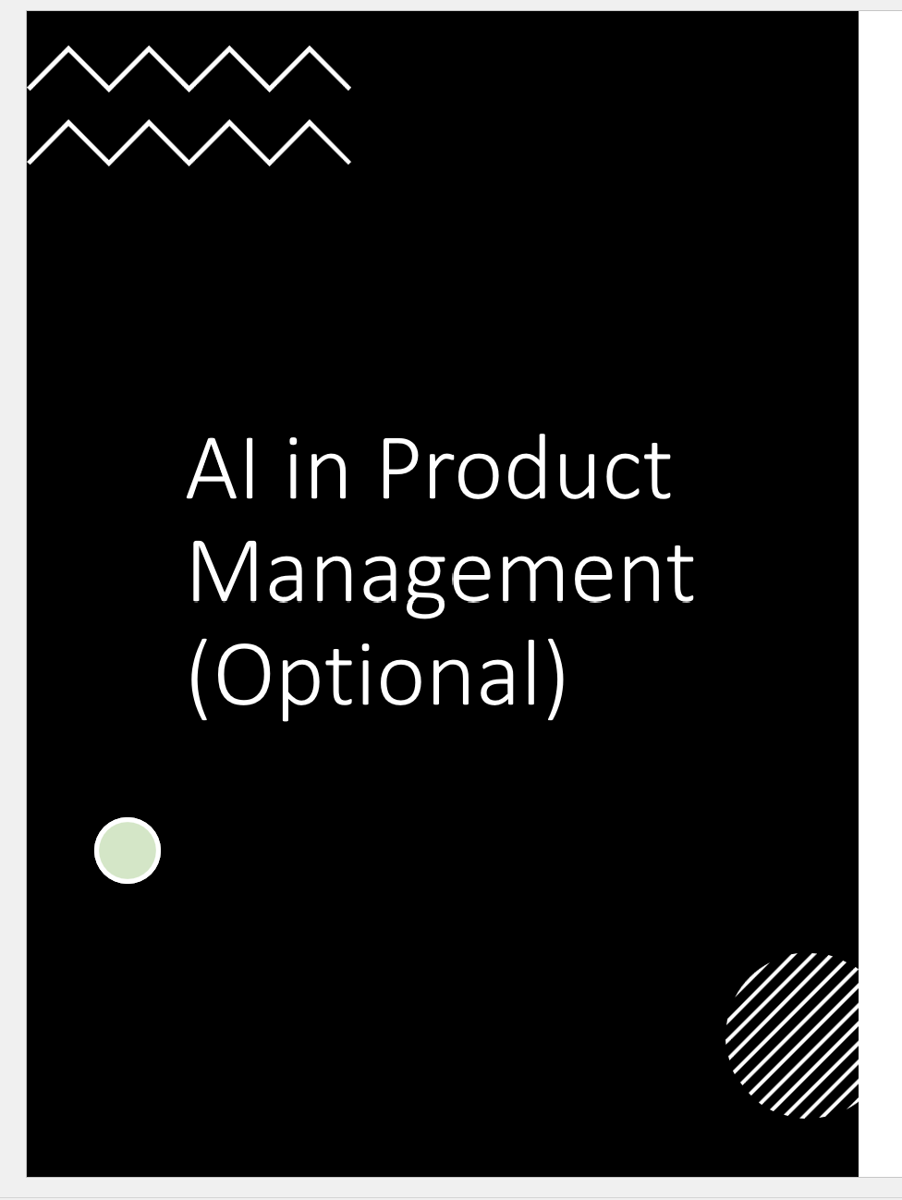
How to do Customer Centric Product Design (Optional)
OR

Slide 27

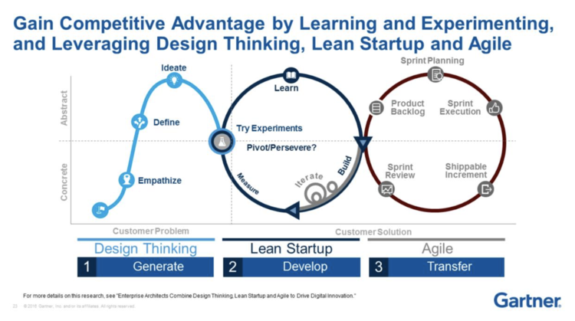
Integration of approaches
Design Thinking: works in close collaboration with the user to understand their pain points, problems, and potential solutions.
Lean Startup: emphasizes the need to test hypotheses via frequent experiments that reveal customer preferences and behaviour through objective metrics.
Agile Development: is a method of working in smaller batches with a focus on the highest priority tasks/stories, leading to shippable work.

Slide 28
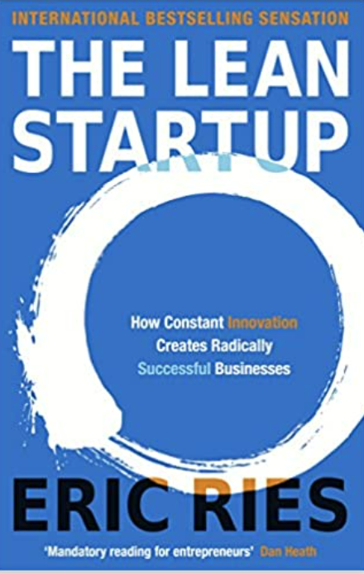
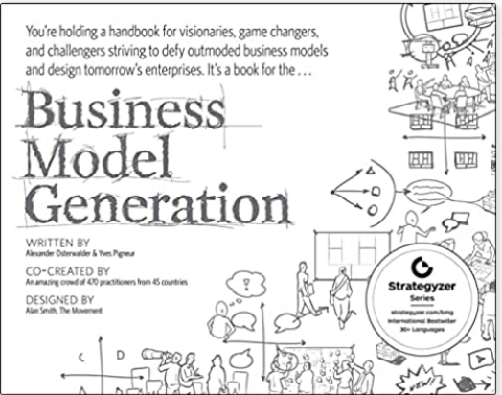
Design Thinking
How to approach a Problem/opportunity
Lean Startup
How to develop & validate your soluton
Strategyser/BMC
Agile
System to build &Scale
Verify the solution/Business model developed will work in real life
Designing thinking is a process that aims to radically change how you solve a problem by diversifying the design team and fully understanding a specific user.
Lean startup approaches product improvement and overall production improvement by creating minimal viable products and letting the customer determine value.
Agile is both a methodology for making and scaling your solution with speedy, incremental releases.

Slide 29

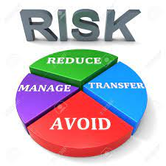
What is the singular objective of structured product design
Menti survey (Why do you need a structured approach for Product Design / Development )

Slide 30
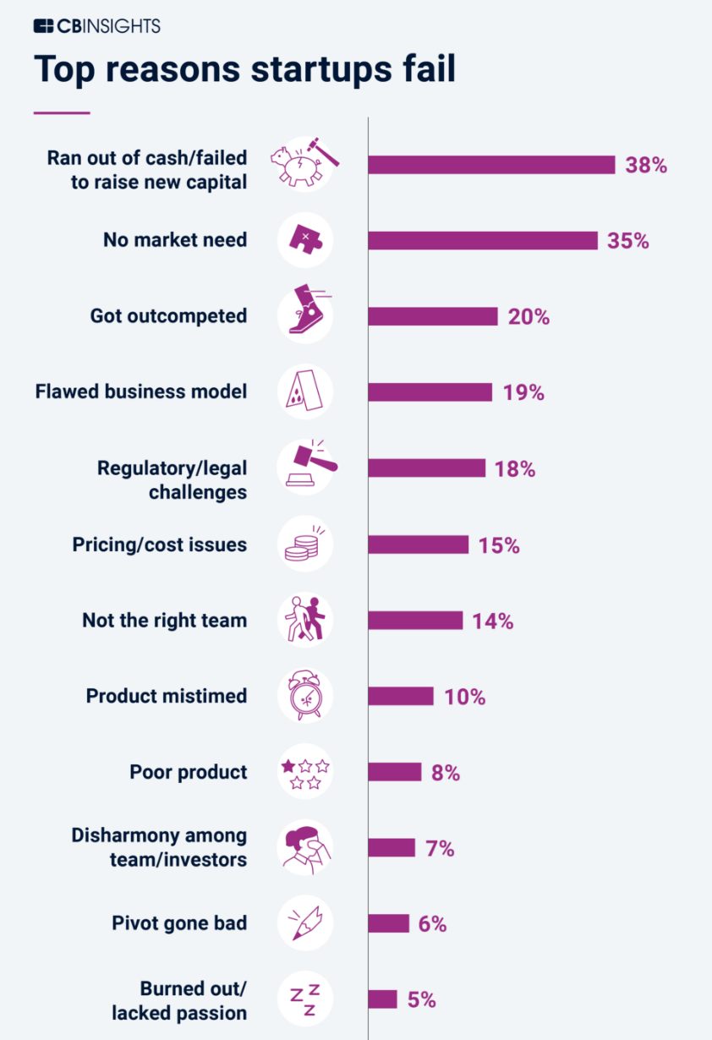
What is the singular objective of structured product design…
Reduce Risk by
Focusing on end customers
Validating Early
Developing solutions Fast
Fail fast
Pivot
Using POC, MVP
Reduce Risk by
Engaging stakeholders/SME early
Test with BMC

Slide 31
Associated theories…
Minimum Viable Product (MVP)
PIVOT
Lean
Validated Learning
Continuous Improvement

Slide 32
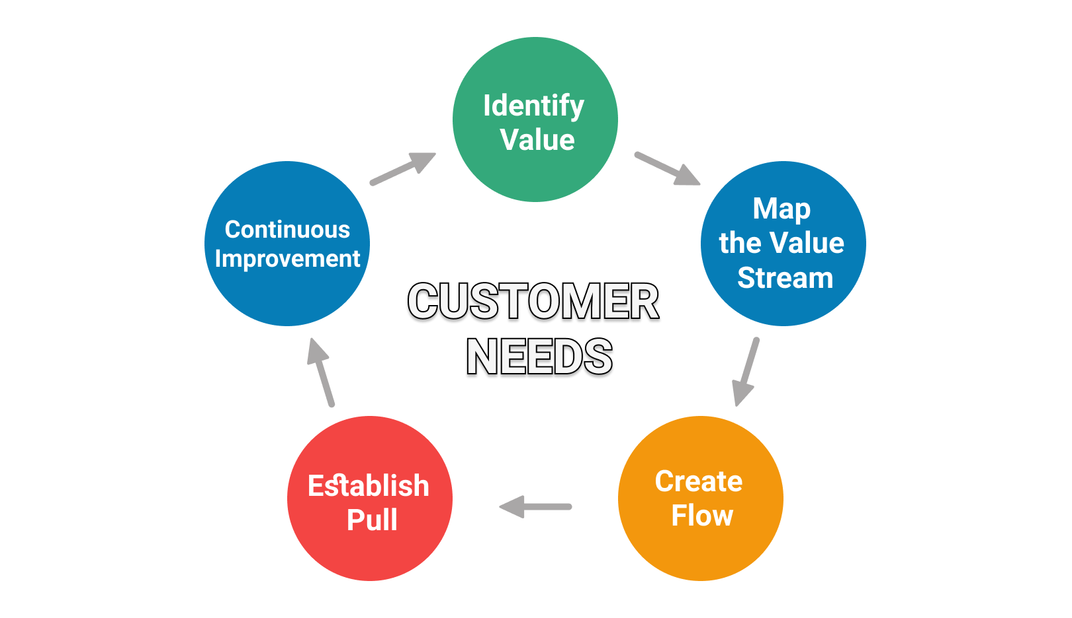
Lean Basics
Do only things that the customers value
Everything else is waste
Eliminate Waste

Slide 33
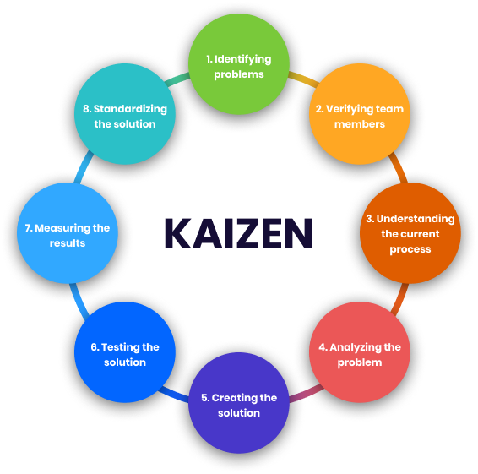
Continuous improvement
Getting better at getting better **

Slide 34
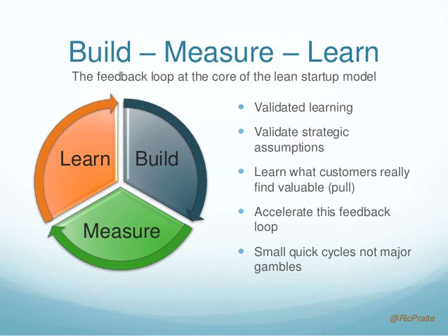
Validated Learning
Continuous testing of your ideas to verify them. Are you sure your customer wants what you think they want?
Are we testing what customer needs
Decide: Should we continue the path..
Why: Shrink development process

